Slide 1





STAT 50 04/07/2021

Slide 2




















Slide 3











Slide 4








Slide 5

















Slide 6














Slide 7























Slide 8








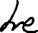




Slide 9
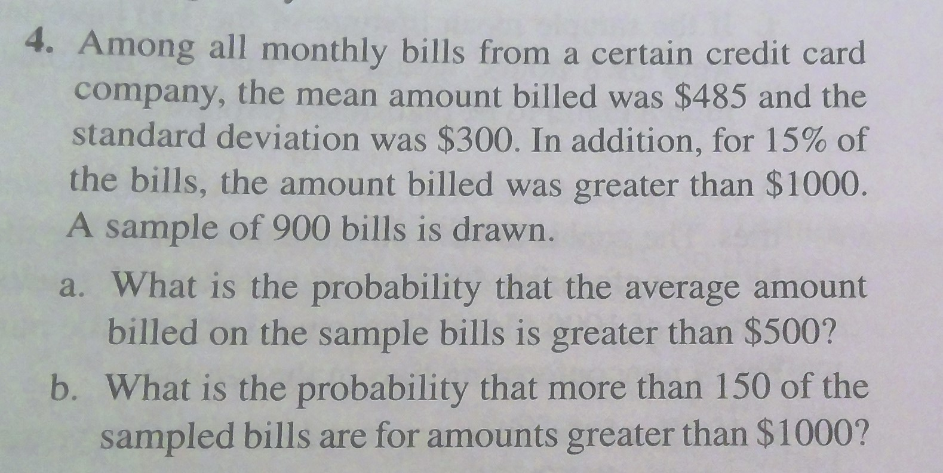


Slide 10














Slide 11














Slide 12










Slide 13





Slide 14
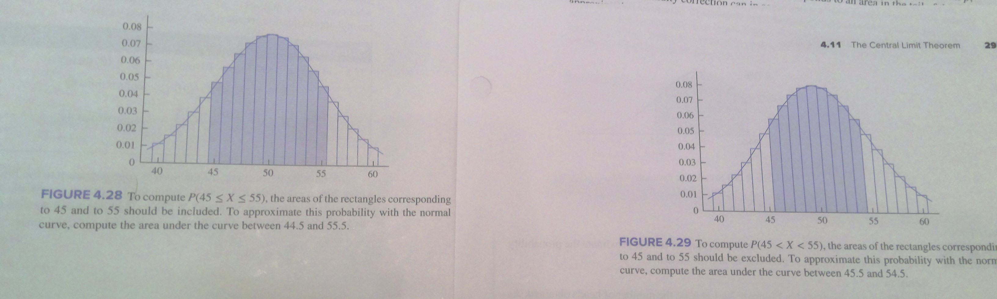

Slide 15









Slide 16




Slide 17



Slide 18
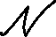


























Slide 19













Slide 20






